Slide 1
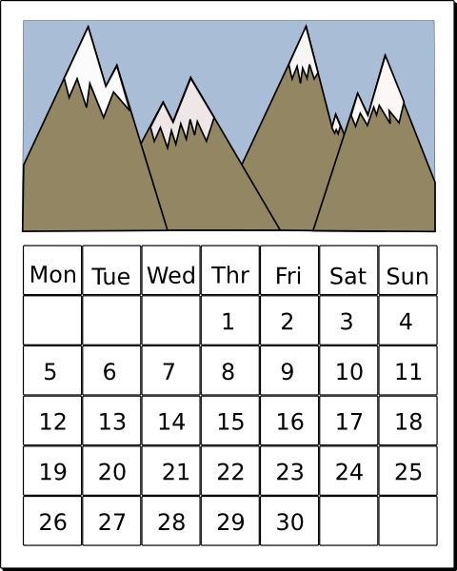
Les jours de la semaine
Lu
Ma
Mi
Je
Ve
Sa
Di
Notes:
Images from www.clker.com

Slide 2
Quelle est la date aujourd’hui ?
Mardi , 14 avril
jour = day
mois = month
date = date
Aujourd’hui = today
Notes:
This routine needs building in during the summer term of Year 3. Asking the class what day and date it is will be a regular feature from now on. NB – the date will need changing on this slide to reflect the date / day of the lesson.

Slide 3
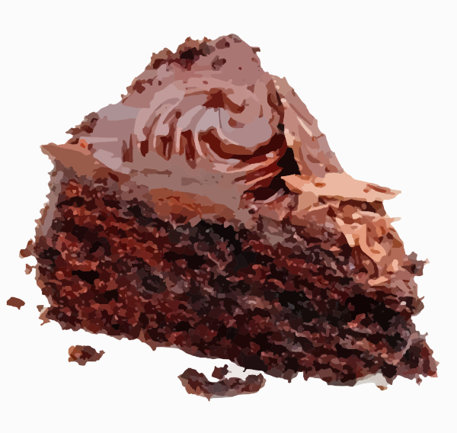
une tranche de gateau au chocolat
Notes:
Audio is attached to the written label (which is colour-coded).

Slide 4

un cornichon

Slide 5

une glace

Slide 6

une tranche de fromage

Slide 7
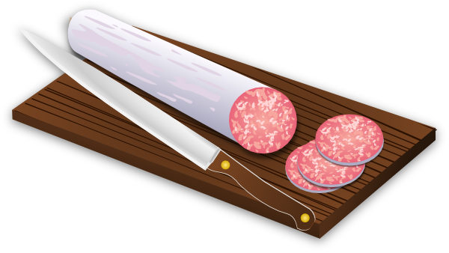

une rondelle de saucisson

Slide 8

une sucette

Slide 9

une portion de tarte aux fruits

Slide 10

une saucisse

Slide 11

une madeleine

Slide 12

une tranche de pastèque
Notes:
Probably best to go back to slide 1 and run through the items again at least once.

Slide 13

une tranche de gateau au chocolat
Notes:
Audio is attached to the written label (which is colour-coded).

Slide 14
un cornichon

Slide 15
une glace

Slide 16
une tranche de fromage

Slide 17
une rondelle de saucisson

Slide 18
une sucette

Slide 19
une portion de tarte aux fruits

Slide 20
une saucisse

Slide 21
une madeleine

Slide 22
une tranche de pastèque
Notes:
Probably best to go back to slide 1 and run through the items again at least once.

Slide 23

Notes:
Qu’estce que c’est ?

Slide 33














Notes:
Pupils should cut these up and put them in order according to the audio they hear when you click the NUMBER on the next two slides.
You could then make up your own order, or elect a pupil to call out a different order if someone is feeling particularly confident.

Slide 34
1
Notes:
Click on audio icon button to listen. Then use the next slide to bring up the answers

Slide 35
Notes:
ANSWER SLIDE. Use a series of clicks to reveal the correct order of items.

Slide 36
2
Notes:
Click on audio icon button to listen. Then use the next slide to bring up the answers

Slide 37
Notes:
ANSWER SLIDE. Use a series of clicks to reveal the correct order of items.

Slide 38
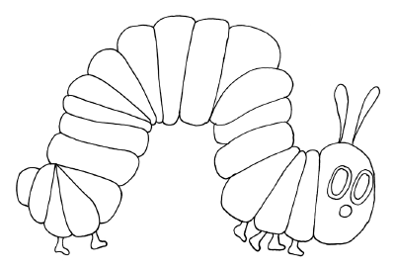
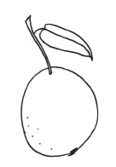
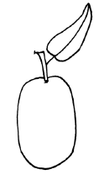
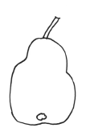

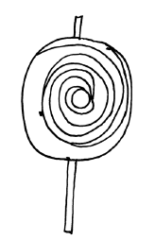
Notes:
Pupils could colour these in and say/write sentences practising the vocabulary and agreement of adjectives of colour. They could then write sentences to describe each item.

